Slide 1
CONGRESS
“Safe road infrastructure: from concept to realization”
Wrocław, December 4-6, 2012
The influence of road solutions on road safety: new tools to design safer roads
Prof. Ing. Francesca La Torre
Florence University / FEHRL
francesca.latorre@dicea.unifi.it

Slide 2
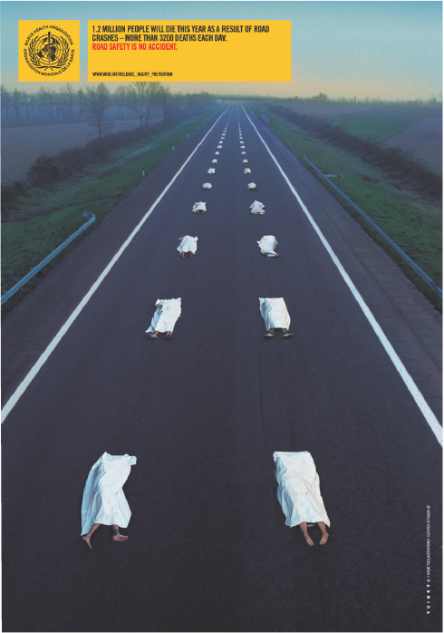
TOWARDS ZERO DEATHS
WHO
1.2 Million people will die this year as a result of road crashes
More than 3200 deaths each day
ROAD SAFETY IS NO ACCIDENT

Slide 3
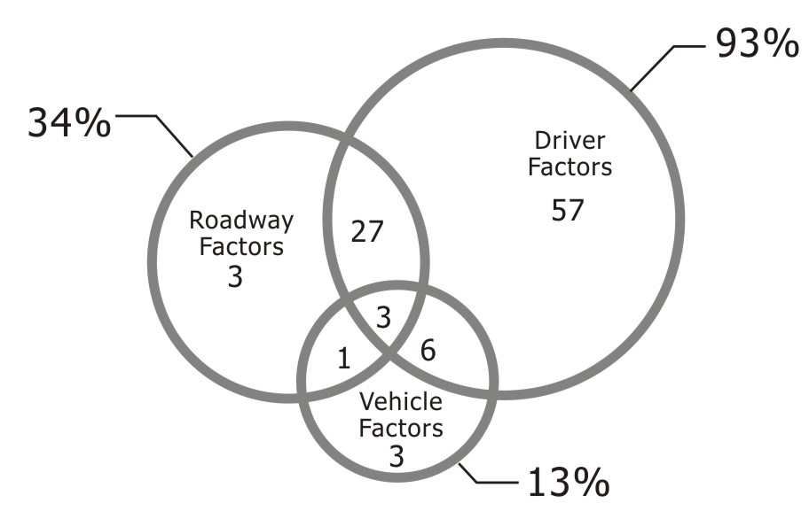
TOWARDS ZERO DEATHS
It is too easy to just think that “the issue is in the driver behaviour”
AASHTO – Highway Safety Manual
Exhibit 3-3: Contributing Factors to Vehicle Crashes (Source: Treat 1979)
Safer roads can contribute, in average, in saving up to 408’000 lives per year

Slide 4
TOWARDS A NEW INFRASTRUCTURE CONCEPT
ADAPTABLE
AUTOMATED
RESILIENT
Source: FEHRL - FOR
… and affordable!

Slide 5
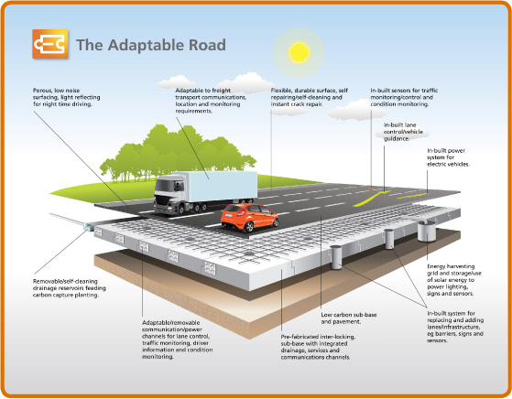
ADAPTABLE
The adaptable road will be based on a pre-fabricated/modular system that can gradually be implemented across Europe’s motorway, rural and urban road networks.
It will adapt to increasing
travel volumes and to
changes in demand for
public transport, cycling
and walking.
It will power vehicles,
harvest solar energy,
measure its own
performance and even
repair itself.
Source: FEHRL - FOR

Slide 6
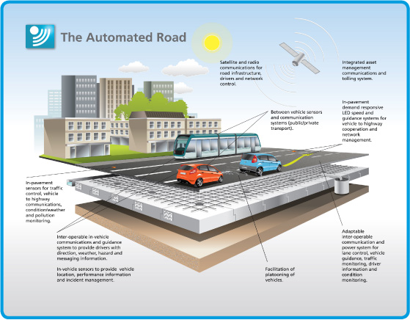
AUTOMATED
The automated road will incorporate a fully integrated information, monitoring and control system; communicating between road users, vehicles and operators. It will support a
cooperative
vehicle-road
system that will manage
travel demand and traffic
movements. It will measure,
report and respond to its
own condition, providing
instant information on
weather, incidents and
travel information.
Source: FEHRL - FOR

Slide 7
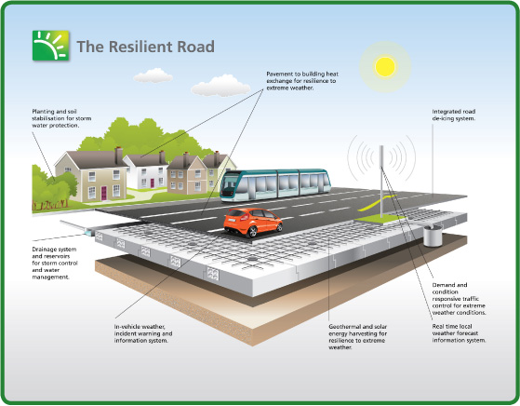
RESILIENT
The resilient road will adapt itself to the impacts of extreme weather conditions and climate change. The road will monitor flooding, snow, ice, wind and temperature change, and mitigate their impacts
through integrated storm
drainage, automatic
heating and cooling,
and will be linked
to the integrated
information system for
travellers and operators.
Source: FEHRL - FOR

Slide 8
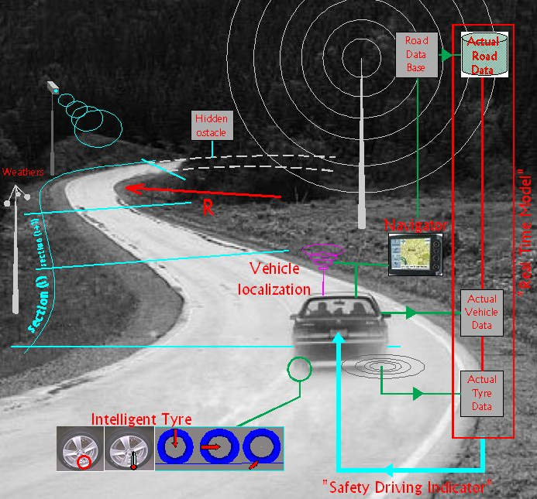
TOWARDS A NEW INFRASTRUCTURE CONCEPT
A SMART ROAD AS PART OF A SMART INTEGRATED TRANSPORT SYSTEM

Slide 9
AND NOW ….. HOW CAN WE DESIGN SAFER ROADS?
IDENTIFY THE SAFETY ISSUE
IDENTIFY BEST PRACTICES (including non conventional solutions)
EVALUATE CONTEXT SENSITIVE SOLUTIONS
EVALUATE COST EFFECTIVENESS OF DIFFERENT OPTIONS
FROM “RECIPES” BASED TO
“PERFORMANCE” BASED DESIGN

Slide 10
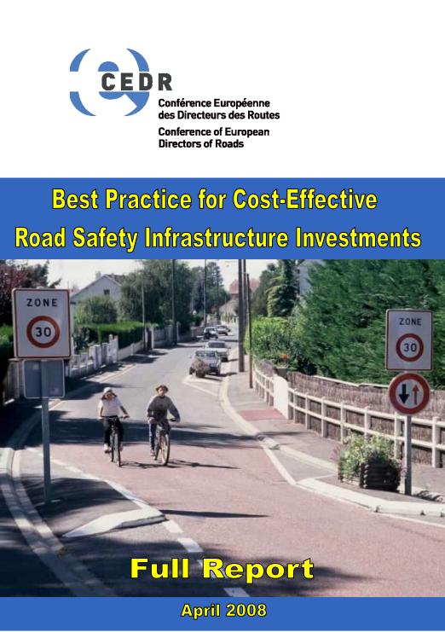
IDENTIFY BEST PRACTICES
http://www.cedr.fr
55 different road safety investments have
been analysed in terms of
potential effectivenness and B/C ratio

Slide 11
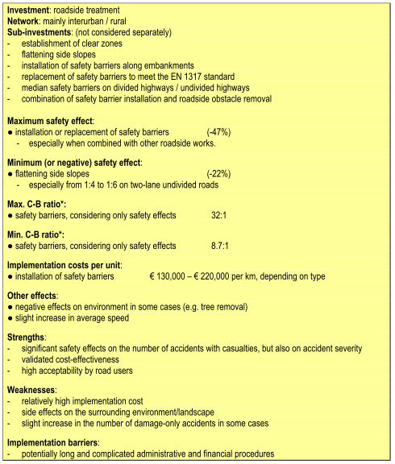
IDENTIFY BEST PRACTICES
ROADSIDE TREATMENTS
http://www.cedr.fr

Slide 12
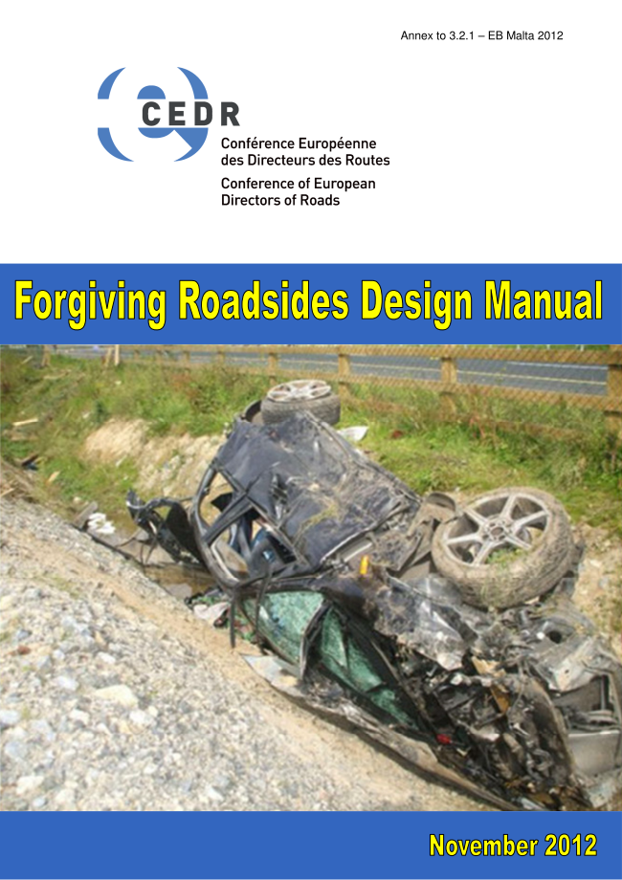
IDENTIFY BEST PRACTICES
4 SPECIFIC ROADSIDE TREATMENTS
ANALYSED IN DETAIL
http://www.cedr.fr
BARRIER TERMINALS
FORGIVING SUPPORT STRUCTURES FOR ROAD EQUIPMENT
SHOULDER RUMBLE STRIPS
TO BE PUBLISHED
SHOULDER WIDTH
  Design criteria;
  Assessment of effectiveness;
  Case studies/Examples;
  References.

Slide 13
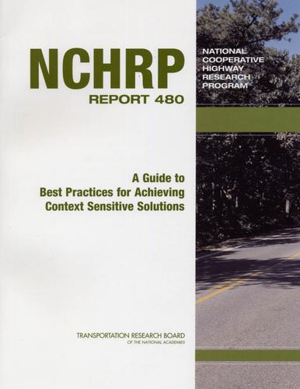
EVALUATE CONTEXT SENSITIVE SOLUTIONS
Selecting a Design Speed
Design Traffic and Level of Service
Nominal and Substantive Safety Thresholds
…………
ESSENTIAL IN ROAD UPGRADING AND URBAN AREAS
http://contextsensitivesolutions.org

Slide 14
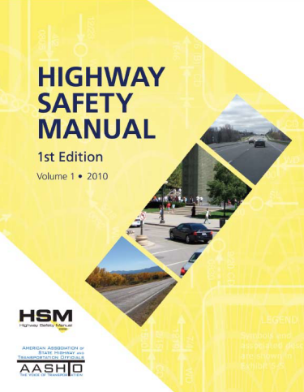
EVALUATION OF COST EFFECTIVENESS
OF ROAD DESIGN FEATURES
N = C x N_{base} x CMF₁ x CMF₂ x CMF₃ ….
Each design feature can be characterized by means of a Crash Modification Factor
The same safety performance can be achieved by means of different designs

Slide 15
BARRIERS TO THE DESIGN OF PERFORMANCE BASED SOLUTIONS
Cultural barriers: the quantification of cost-effectiveness if often considered unreliable and there is a need for a standardization of tools and procedures;
Standardization barriers: most national standards do not allow for performance based design or context sensitive solutions allowing only to use a specific set of given solutions;
Availability barriers: for several safety treatments reliable CMFs are still not available (e.g. ITS technologies)

Slide 16
AN EXAMPLE ……
I have a 100 km/h of secondary rural roads with very old safety barriers
A full rehabilitation according to current Italian standards will cost me €€€€€€€€€
What are the expected benefits in terms of fatalities and severe accidents reduction?
And if I do a reduced upgrade but on 200 km roads with the same €€€€€€€€€

Slide 17
CONCLUSIONS AND RECOMMENTATIONS
The road of the future will be “adaptable”, “automated”, “resilient” and part of a fully integrated SMART SYSTEM;
To design safer roads we need to be able to identify the best practices to adapt them to the specific context and to choose the most cost effective;
New design and evaluation tools are available and are under development to assist the designer in choosing the most cost-effective solutions;

Slide 18
CONCLUSIONS AND RECOMMENTATIONS
We need to change designers attitude: designing with “cookbooks” is easier that aiming at a given performance;
We need to change most of our national design standards that do not allow performance based design;
We need reliable cost effectiveness evaluation tools and we need to tailor the existing ones to local conditions (calibration & transferability);
We need CMFs for new safety solutions as ITS.

Slide 19

Thank you all for listening …

